Slide 1
Comparison of Collaborative Filtering Algorithms
100K MovieLens Dataset
Name: Bo Yang
Professor: Xifeng Yan, Tao Yang
Computer Science Dept.

Slide 2
What is recommendation?

Slide 3


Slide 4
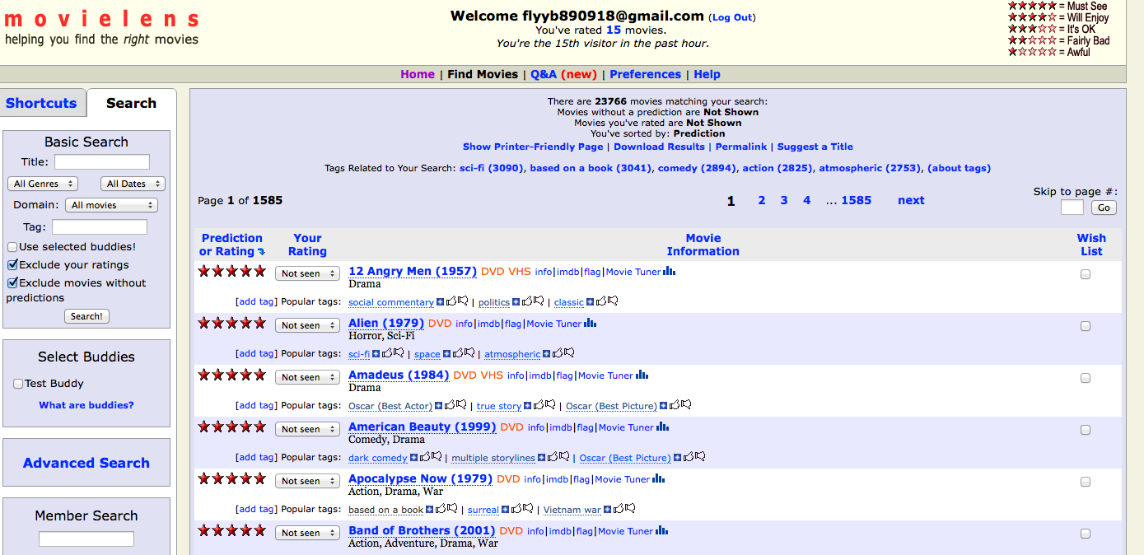

Slide 5
Background & Motivation
Recommender System
E-commerce
Web Search
TV recommender

Slide 6
Background & Motivation
Personalized recommendations have become more and more important nowadays. Users want a system which is not limited to retrieving the most relevant items, but also more adequate for their tastes and interests. The technique of collaborative filtering is especially successful in generating this kind of recommendations. So the comparison of accuracy and coverage is worthwhile.

Slide 7
Collaborative Filtering
Many recommendations were based on content before. But content-based is insufficient to deal with the multimedia information available today. Another problem is if the contents of two articles are similar, it is very hard for the machine to analyze.

Slide 8

Very similar!

Slide 9
Collaborative Filtering
Collaborative Filtering is less sensitive to these problems since it it not based on the content of items but rather on the ratings of other users, who have similar tastes or interests.

Slide 10
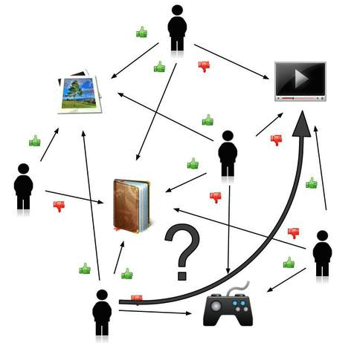

Slide 11
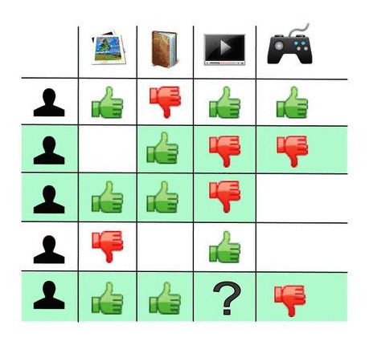

Slide 12
Before we start

Slide 13
Notation
User set U = {u1, u2, …, um}
Movie set I = {i1, i2, …, im}
Set Iu: All the movies which user u has rated
Set Ui: All the users who have rated the movie i
Rating range: 1-5
uAVG: The average rating which is given by one user
iAVG: The average rating which the movie has
Active user: The user which we want to predict
Active movie: The movie which we want to predict

Slide 14

Dataset
The MovieLens dataset contains real data corresponding to movie ratings captured on the website of MovieLens movie recommender during a 7-month period (19-09-1997 to 22-04-1998). In this project, the size of data set is (80,000 ratings from 943 users on 1682 movies) . The ratio of the number of items to the number of users is 1.78, and the density is 6%.

Slide 15
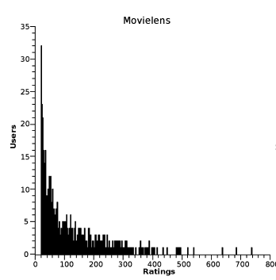
Dataset

Slide 16
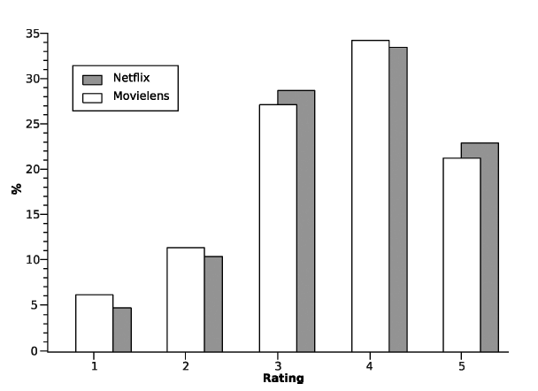
Dataset

Slide 17
Task Instruction
The task for this project is to predict the rating which the user may give to the movie he or she has never rated (Basically the annotation in context problem). Four algorithms have been chosen to use and evaluation of both accuracy and coverage has been done.
Realize four CF algorithms
Use script to generate different training dataset from 15% to 90% and one 10% evaluation dataset
Accuracy evaluation
Coverage evaluation

Slide 18
Methodology
The experiments were performed by dividing the dataset into two groups, a training subset and an evaluation subset. For the training dataset, we choose 15%, 20%, 30%, 40%, 50%, 60%, 70%, 80% and 90% from the original dataset. For the evaluation dataset, we choose 10% of the original dataset. And the ratings that appear in the evaluation subset cannot be included in the chosen training set.
In the experiment, we choose 4 algorithms: User-based, Item-based, Slope-one and Tendency-based algorithm. For the evaluation, we use MAE method. Evaluation will cover both the coverage of the algorithm and the accuracy of the algorithm.

Slide 19
Algorithm Details

Slide 20


Item-based
Input:
100K UID MID Rating Date
The structure may not be very formal and convenient for us to run the item-based algorithm. So the preprocess need to be used here. For the great key and value attribute of Map Reduce, we use it to do the collection and preprocess before we run the actual KNN item-based algorithm.
So what is map reduce?

Slide 21
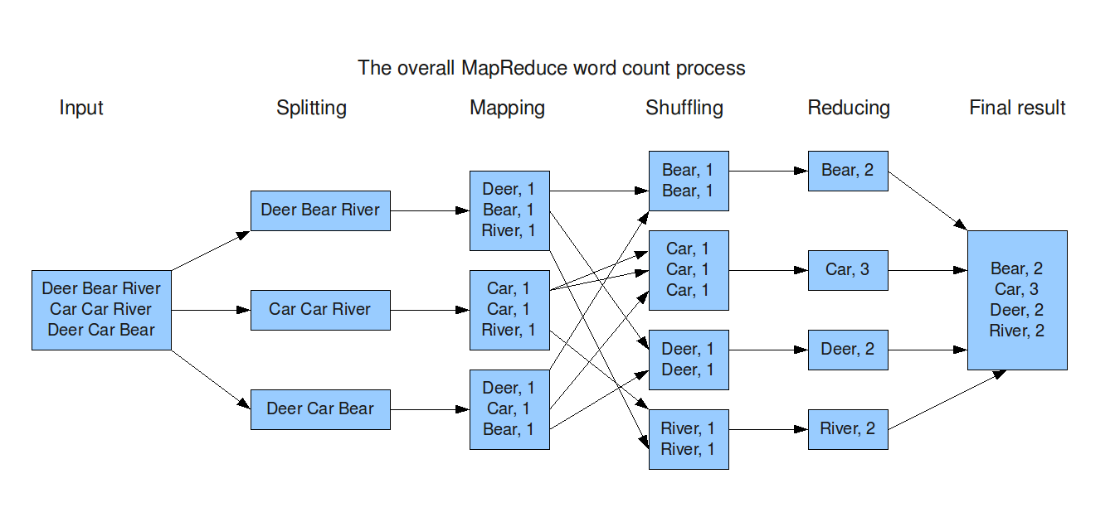
MapReduce

Slide 22
Collection
Map Input:
Each line from the original dataset
Map Output
UserID collector<Movie, Rating>
Reduce Input
UserID collector<Movie, Rating>
Reduce Output
UserID Sorted Array<collector<MovieID, Rating>> based on MovieID

Slide 23
Item-Preprocess
Map Input:
UserID Sorted Array<collector<MovieID, Rating>> based on MovieID
Map Output:
MovieID, collector<UserID, UserAvg, UserRatingForMovieID>
Reduce Input:
MovieID, collector<UserID, UserAvg, UserRatingForMovieID>
Reduce Output:
MovieID, Sorted Array<Collector<UserID, UserAvg, UserRatingForMovieID>> based on UserID

Slide 24
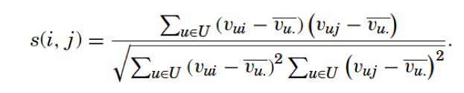
Item-KNN algorithm
To calculate the similarity between two movies, we need the id of these two movies and the value lists of these two movies. These values can be easily got because they are return directly by the reduce result of the preprocess. The formula is below.
Find the common user which has rated both movie i and movie j. After calculating the similarity between every two movies, the output of KNN algorithm can be something like
MovieID, Sorted Array<Collector<neighbourID, similarity>> based on the value of similarity.

Slide 25

Item-Query
Last step is try to calculate the predict the user’s rating to the specific movie which is defined in the evaluation dataset. Two local memory is used in this process.
The NM store all the neighbors of the movie which we want to predict. The UM store all the movie information which the active user has rated. Active user is the user which we want to predict.
Local Memory NM
MovieID
KNN
UserID
User SubSet
Local Memory UM

Slide 26
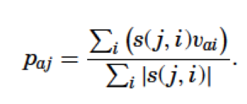
Item-Query
After we get both the NM and RM, we can use the formula below to calculate the predict rating which the active user will give to the active movie.
We find the top 10 neighbor in the NM and find the rating in the RM to see whether the active user has rated these neighbors. If so, use them to calculate the result.

Slide 27
Problem in Item-Query
If the NM is null, then the active movie, the one which we want to predict, doesn’t have any neighbors. That means no common user has rated both the active movie and any other movie in the training dataset. If the UM is null, then the active user has never rated any movie in the training set. Both of these two cases are invalid cases because of the sparse training dataset.
Another problem is both of these two memory is not null, but we find that active user has never rated any neighbor in NM. This problem is also caused by the sparse training dataset.

Slide 28
User-Based
User-based is very similar to item-based algorithm. They are both memory-based CF algorithm. The difference is item-based use the similarity between the active movie and its movie neighbors, while user-based use the similarity between the active user and its user neighbors. Like the item-based algorithm, user-based algorithm also has four steps: collection, preprocess, KNN and query. The collection is the same, so let’s start with the preprocess.

Slide 29
User-Preprocess
Map Input:
UserID Sorted Array<collector<MovieID, Rating>> based on MovieID
Map Output:
UserID, collector<MovieID, UserAvg, UserRatingForMovieID>
Reduce Input:
UserID, collector<MovieID, UserAvg, UserRatingForMovieID>
Reduce Output:
UserID, Sorted Array<Collector<MovieID, UserAvg, UserRatingForMovieID>> based on MovieID

Slide 30
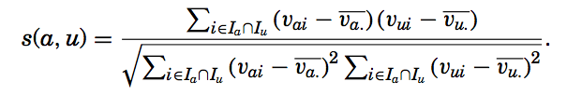
User-KNN algorithm
To calculate the similarity between two users, we need the id of these two users’ id and the value lists these two users. These values can be easily got because they are return directly by the reduce of the preprocess. The formula is below.
Find the common movie which has been rated by both user i and user j. After calculating the similarity between every two users, the output of KNN algorithm can be something like
UserID, Sorted Array<Collector<neighbourID, similarity>> based on the value of similarity.

Slide 31
User-Query
Last step is try to calculate the predict the user’s rating to the specific movie which is defined in the evaluation dataset. Two local memory is used in this process.
The NM store all the neighbors of the active user which we want to predict. UM store all the users’ rating information from the training dataset.
Local Memory NM
UserID
KNN
User SubSet
Local Memory UM

Slide 32
User-Query
After we get both the NM and RM, we find the top 10 neighbor in the NM. These users are very similar to the active user, which we want his/her rating to the active movie. Then find these users’ rating to the active movie in RM. User their average rating to predict the rating.

Slide 33
Problem in Item-Query
If the NM is null, then the active user, doesn’t have any neighbors. That means no common movie has been rated by both the active user and any other user in the training dataset. It may be caused by insufficient amount ratings by users or insufficient amount users.
If the UM is null, the problem is really serious. We cannot search for any users’ ratings.
Another problem is both of these two memory is not null, but we find that all the neighbors have never rated to the active movie (Some users have rated just a few movies). This problem is also caused by the sparse training dataset.

Slide 34
Tendency-based
What is tendency?
The concept of tendencies refers to whether a user tends to rate items positively or, on the contrary, negatively.
Tendency is not average rating. A user which only rates good items will have a good average rating value. But if many users like this movie very much, the movie will have a very high rating. So the user with high average rating may rate this movie negatively.
Formally, the tendency of the user is the average difference between his rating and the movie’s mean rating.

Slide 35
Tendency-based
What is tendency?
Formally
The tendency of the user is the average difference between his rating and the movie’s mean rating. (Whether this user’s rating stands out from others who rate to a movie)
The tendency of the movie is the average difference between the movie’s rating and this user’s mean rating. (Whether this movie ‘s rating stands out from others rated by a user)

Slide 36
Tendency-based
Tendency-based use the difference instead of the similarity. To get the predict rating by tendency-based algorithm, we need both the preprocess result of item-based and user-based.
UserID, Sorted Array<Collector<MovieID, UserAvg, UserRatingForMovieID>> based on MovieID
MovieID, Sorted Array<Collector<UserID, UserAvg, UserRatingForMovieID>> based on UserID

Slide 37
Tendency-based Preprocess
Save both results. We need to put the result of item-based preprocess into the MovieInfo memory space, while put the result of user-based preprocess into the UserInfo memory space.
Item-Preprocess
MovieInfo
User and Movie Tendency
User-Preprocess
UserInfo

Slide 38
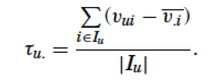
User Tendency
To calculate the user-tendency, we need to get the rating which the active gives to the specific movie and this movie’s average rating.
AvgRating
MovieInfo
UserID
UserInfo
The rating this user has given to a movie

Slide 39
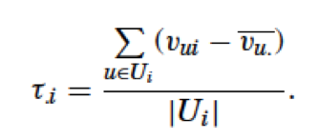
Movie Tendency
To calculate the movie-tendency, we need to get the rating which a user gives to the active movie and this user’s average rating.
AvgRating
UserInfo
MovieID
MovieInfo
The rating this movie has been given by a user

Slide 40



Tendency-based Query
Both user tendency and movie tendency are positive
Both user tendency and movie tendency are negative
One of them is negative and another is positive (avg matches?)

Slide 41
Slope-one
Unlike the previous three algorithms, slope-one is the model-based algorithm. Before we get to the query step, a predictor need to be calculated based on the training set. For example, in the slope-one algorithm, a predictor like y = x + b will be got after the training step. The query of model-based algorithm is very easy and the only thing need to do is use this predictor or model to predict the result.

Slide 42
Training phase
Reformat the raw dataset.
Get the active user and active movie from the evaluation set.
Get one movie from all the movies which the active user rated
Go through all the users and find those users who have rated both the active movie and the chosen movie.
Save all these users to the LIST, each movie has one LIST
Calculate the difference between these two ratings of all the users in the LIST and get the average value: DEV
Get all the DEV of all the movies and get the average value: constant value b

Slide 43

Query Phase
Since we get the constant value of the constant value b, the predictor y = x + b can be used to calculate the rating. The formal expression is below:
The only problem we have in the training phase is there is no user who rated to both the chosen movie and the active movie in the training set.

Slide 44

MAE
In this project, MAE (Mean absolute error) is used as a prediction accuracy evaluation method. The mean absolute error measures the difference, as absolute value, between the prediction of the algorithm and the real rating. It is computed over all the ratings available in the evaluation subset, using the formula:

Slide 45
Evaluation Results

Slide 46
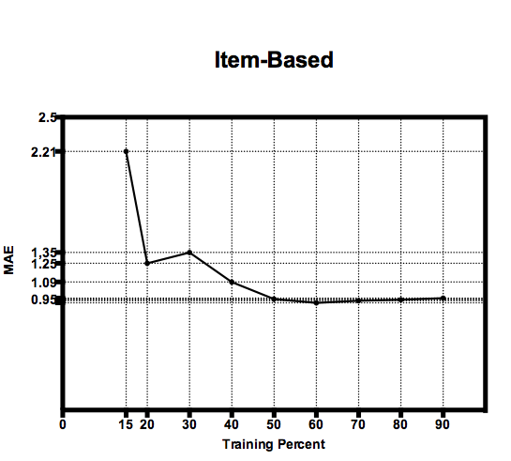

Slide 47
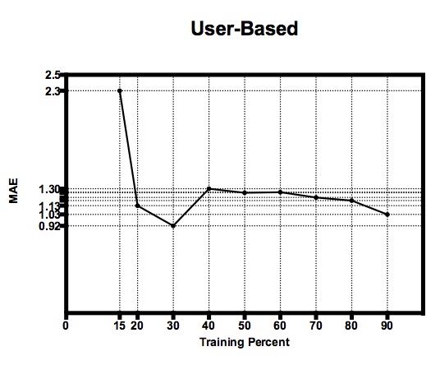

Slide 48
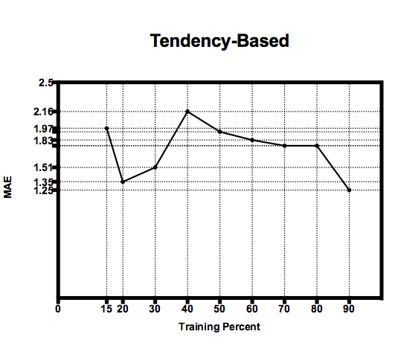

Slide 49
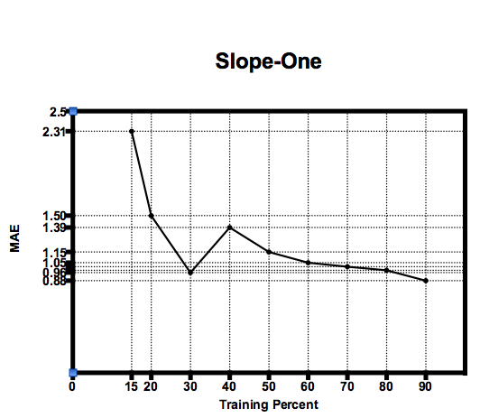

Slide 50
Coverage
The size of the evaluation dataset is 8367
The size of 90 item-based result is 6902
The size of 90 user-based result is 7155
The size of 90 tendency-based result is 7156
The size of 90 slope-one result is 7155

Slide 51
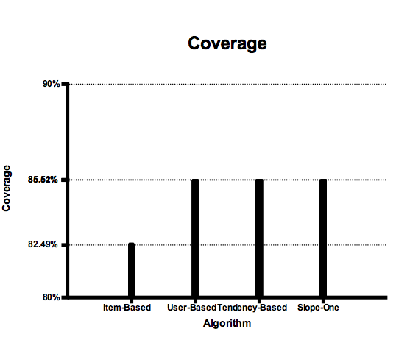

Slide 52
What can we get?

Slide 53
Conclusion I
From the figures in the previous slides, we can see that the accuracy of a prediction is limited by the amount of information that is actually present in the matrix, that is, by its density. As observed, exclude the unexpected image jag, the results under high density conditions are pretty good in all the algorithms.

Slide 54
Conclusion II
Memory-based algorithm (item-based and user-based) is very sensitive to density changes so the results decreases considerably under sparse conditions. Item-based is more static than user-based because the similarity is more static than the one between users. Neighborhood can be computed offline.
Model-based algorithm (slope-one) is less sensitive to the density changes and the decline is relatively a bit smoother. But the actual construction of the model discards part of the information, it is less accurate than memory-based under high density conditions (like item-based). Also, the accuracy of model-based algorithm depends on how the model really fits the specific data. It’s more complex to choose the best predictor model. Slope-one may not be the best model for MovieLens dataset.

Slide 55
Conclusion III
Tendency-based doesn’t work so well for my specific evaluation in the project. It may be caused by the size of input dataset or the chosen parameter in the formula (contribution and mean value). But it still has some shining point.
During the calculation process, we only focus on whether we have user or movie in the given dataset. We don’t focus on whether we have have common user or movie. In the user-based algorithm, we also care about whether neighbor has rated to the active movie.
The sparse rating matrix problem of the tendency-based algorithm is smaller and less serious than some classic memory-based algorithm like item-based and user-based algorithm. So the converge of the algorithm can be better. Fewer data is needed than those needed to find relationships, so computation time and memory requirements are better.

Slide 56
Conclusion IV
Which algorithms is the best?
It’s very hard to say since each algorithm has its own strong point and weakness depends on what you want to predict. Many factors like the category of the dataset, the amount of the dataset, the percentage of the training set and evaluation set, running environment, etc., will effect the evaluation result. In my specific experiment, item-based algorithm has the best comprehensive manifestation.

Slide 57
Future Work
More Collaborative Filtering algorithm evaluation: Similarity Fusion, Regression-based, SVD, Regularized SVD, Integrated neighbor-based-SVD model, Cluster-based smoothing, Personality diagnosis
User multiple machines to speed up the preprocess and training step. Dataset can be split evenly to different remote machines and use MapReduce to preprocess.
More dataset type and size evaluation. NetFlix, EachMovie or other kind of dataset from different domains can be used. The size can also be extended to 1 million or 10 million. Different results will be generated because of the modification of the input dataset.
More choices of the percent of training set and evaluation set.

Slide 58
Reference
[1] Fidel Cacheda, Vctor Carneiro, Diego Fernandez, and Vreixo Formoso. Comparison of collaborative Filtering algorithms: Limitations of current techniques and proposals for scalable, high-performance recommender systems. ACM Trans. Web, 5(1), February 2011.
[2] Yao Wu, Qiang Yan, Danny Bickson, Yucheng Low, Qing Yang. Efficient Multicore Collaborative Filtering. Cornell University Library. 17 Aug 2011.
[3] Daniel Lemire, Anna Mackachlan. Slope One Predictors for Online Rating-Based Collaborative Filtering. In SIAM Data Mining (SDM’05), Newport Beach, California, April 21-23, 2005.

Slide 59
Thanks!

